Slide 1

Matrices and Their Real-World Applications

Slide 2
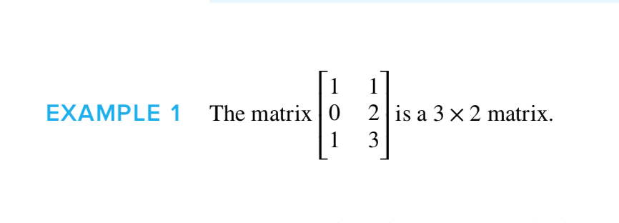

What are Matrices?
A matrix is a set of numbers placed on a rectangle
Typically has m rows and n columns written as m × n
We call two matrices equal if their m and n are equal and for every position in the matrix their numbers correspond

Slide 3


Arithmetic Manipulation
Addition

Slide 4
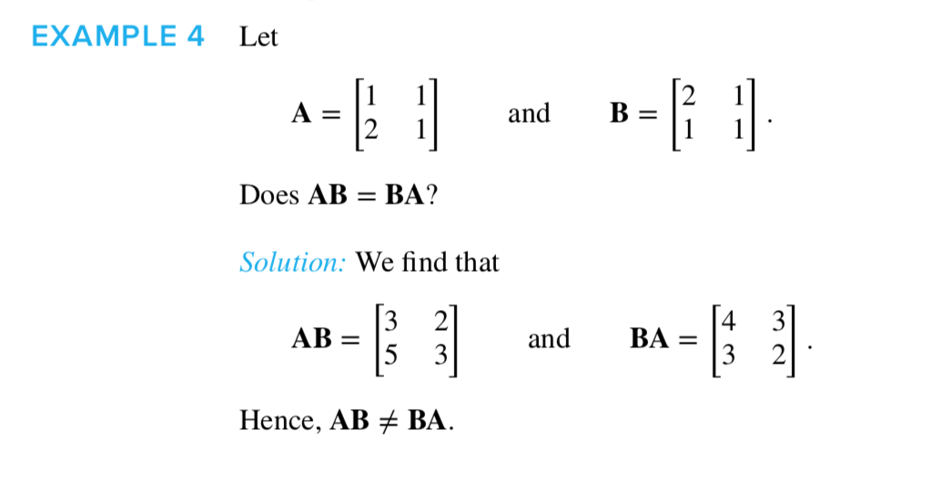
Arithmetic manipulation
Multiplication

Slide 5
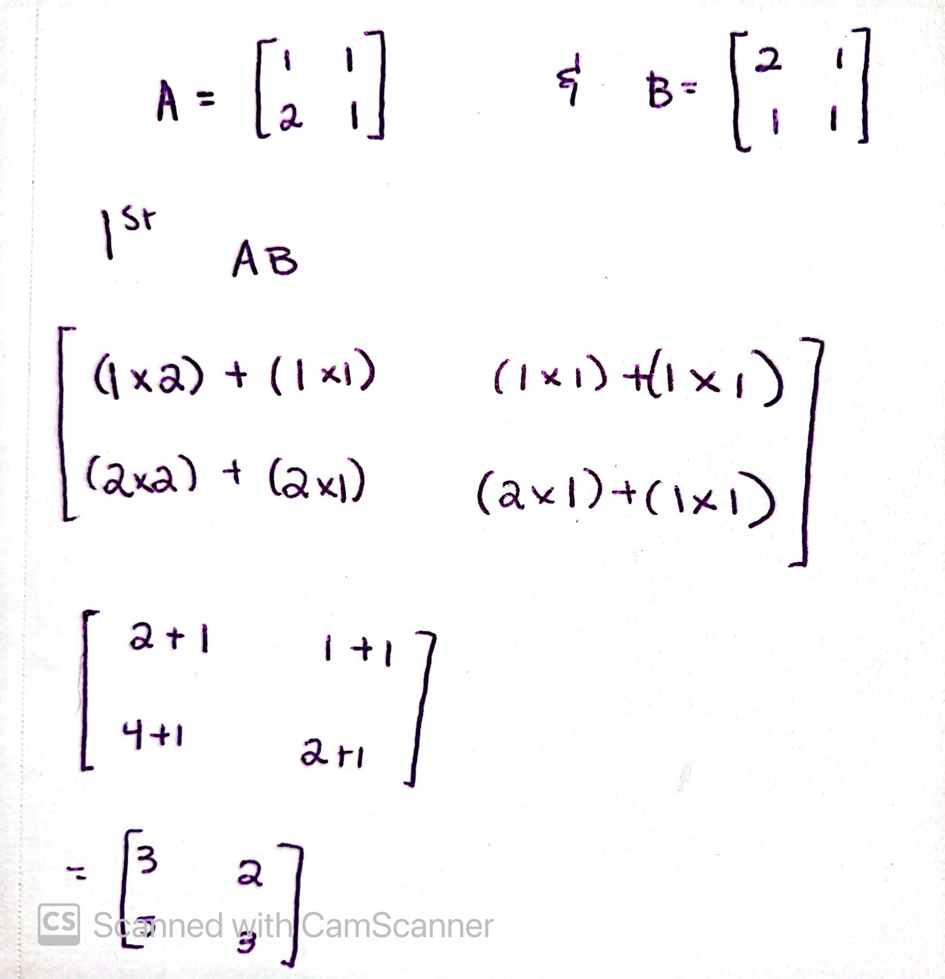
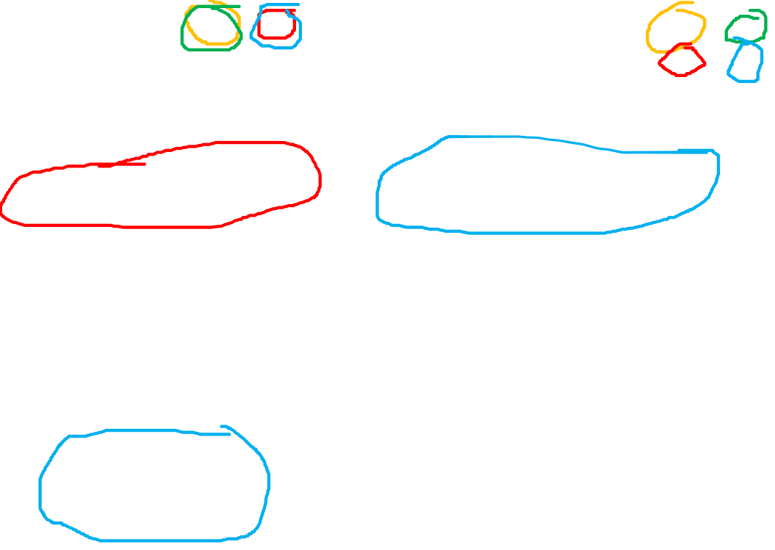
Arithmetic Manipulation

Slide 6
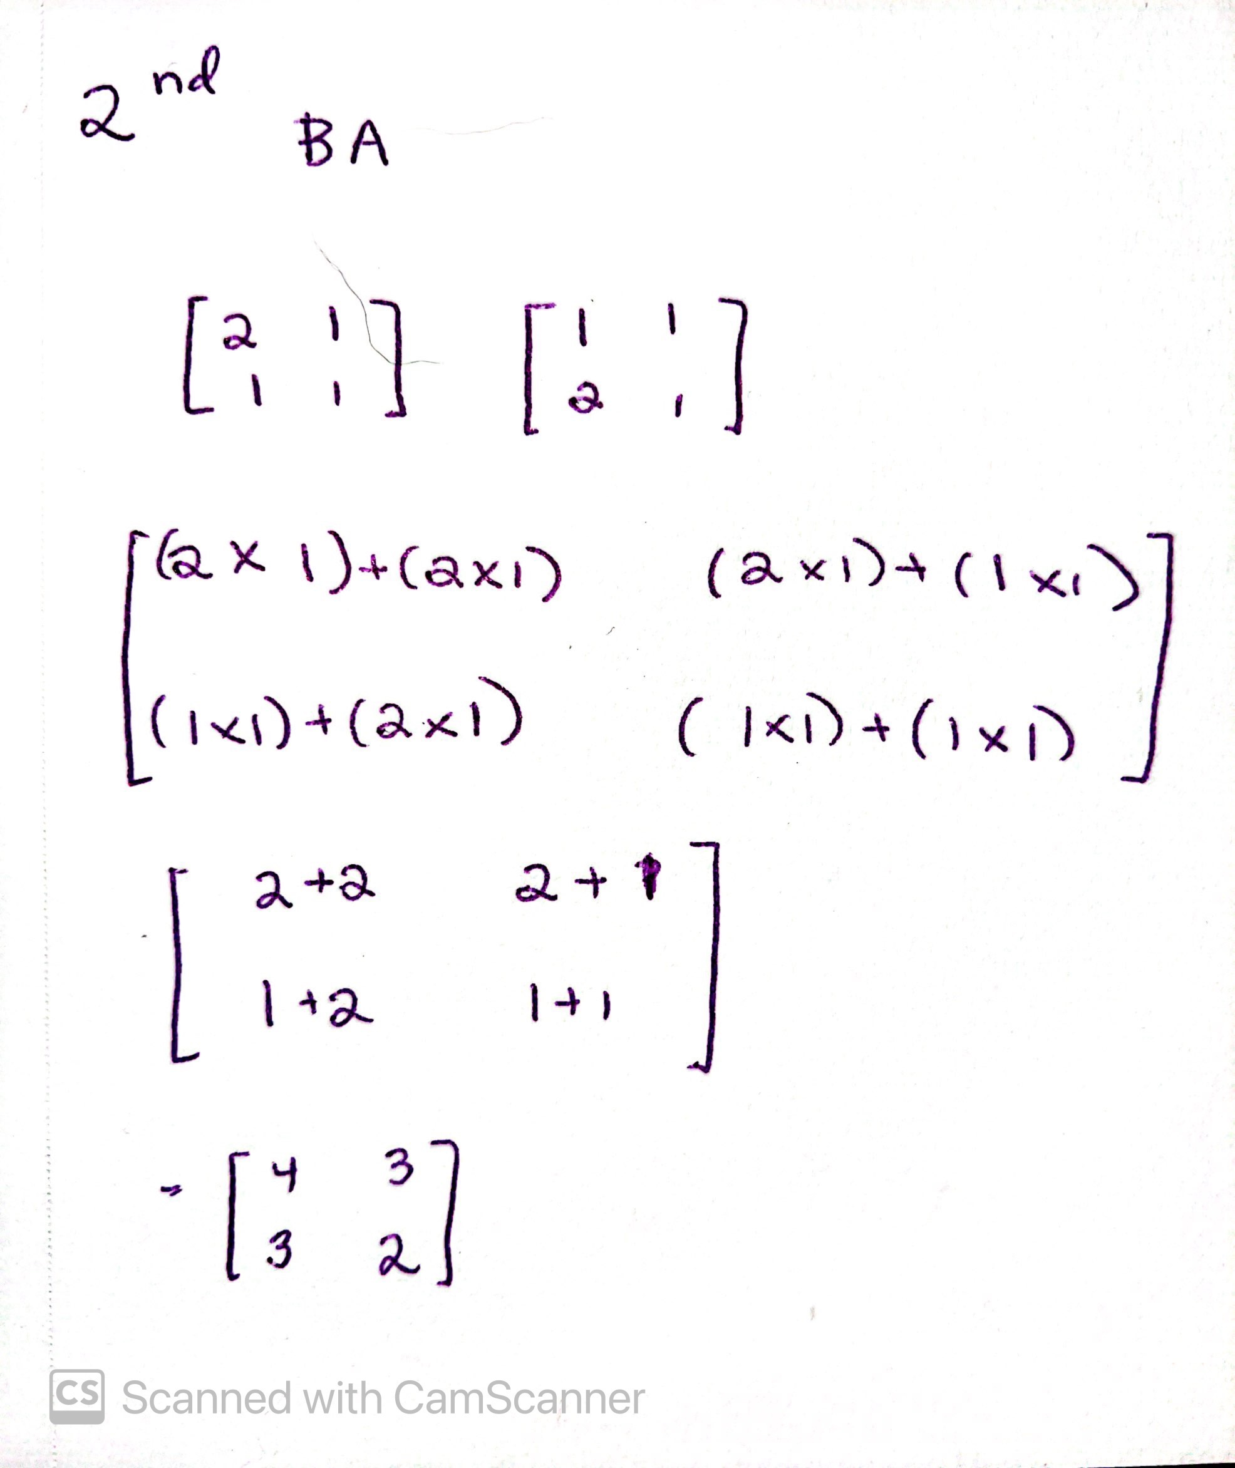

Arithmetic Manipulation

Slide 7

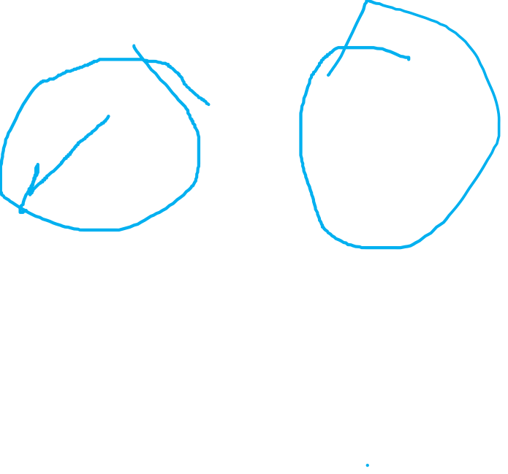
Transposition

Slide 8
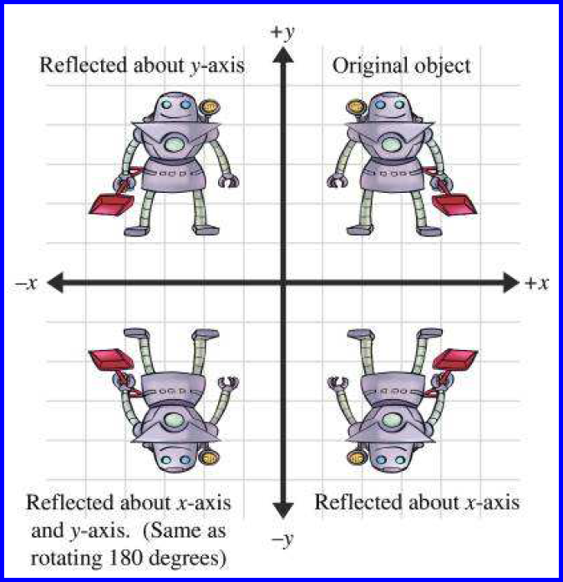
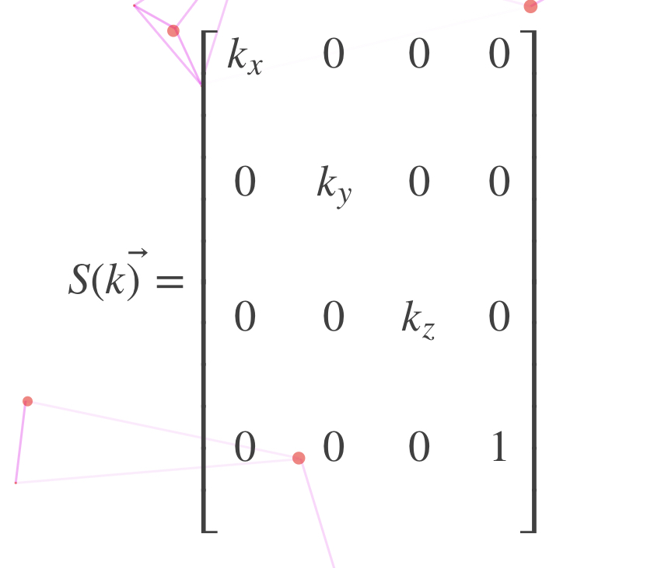

Matrices Applications
Computer Graphics
Used to convert linear transformations to images

Slide 9

Matrices Applications
Construction
Can be used to changed the outer structure of architecture by manipulating the columns and rows of matrices

Slide 10
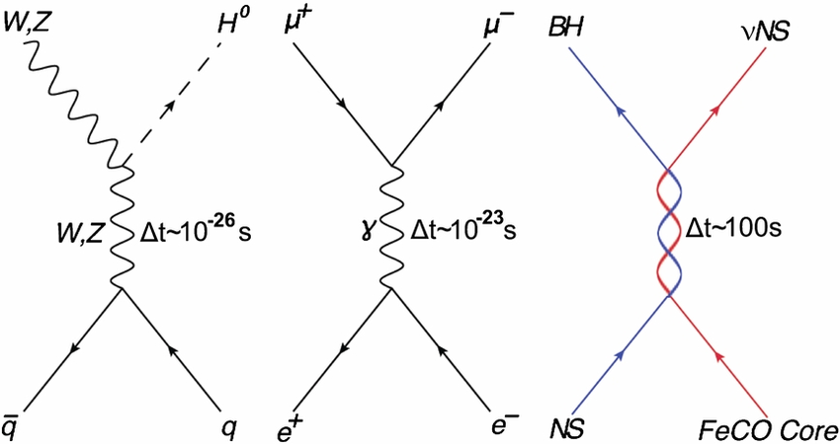

Matrices Applications
Physics
Used in electrical circuits
A/C networks
Quantum mechanics
Conversion of electrical energy

Slide 11
Matrices Applications
Cryptography
Uses an invertible key to encrypt data
Used to encrypt video signals to prevent loss for satellite owners
Encrypted keys can’t go back to their original forms
Uses matrix multiplication

Slide 12
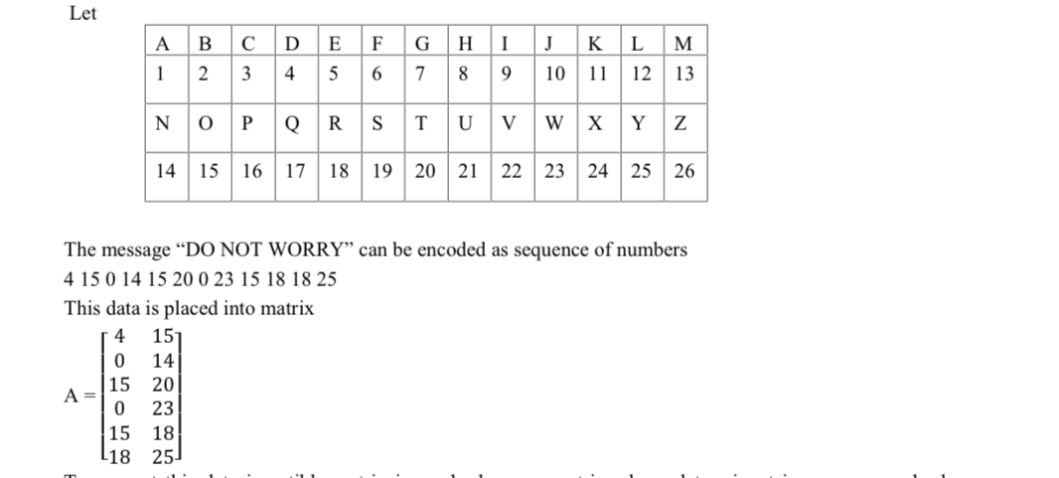


Slide 13
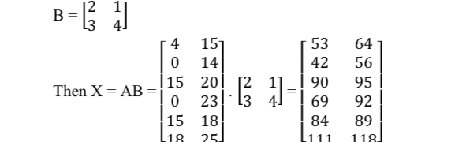


Slide 14
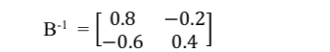

Slide 15
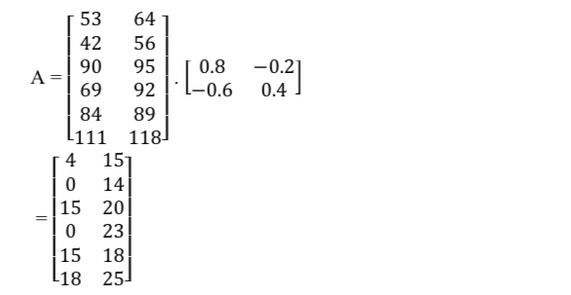
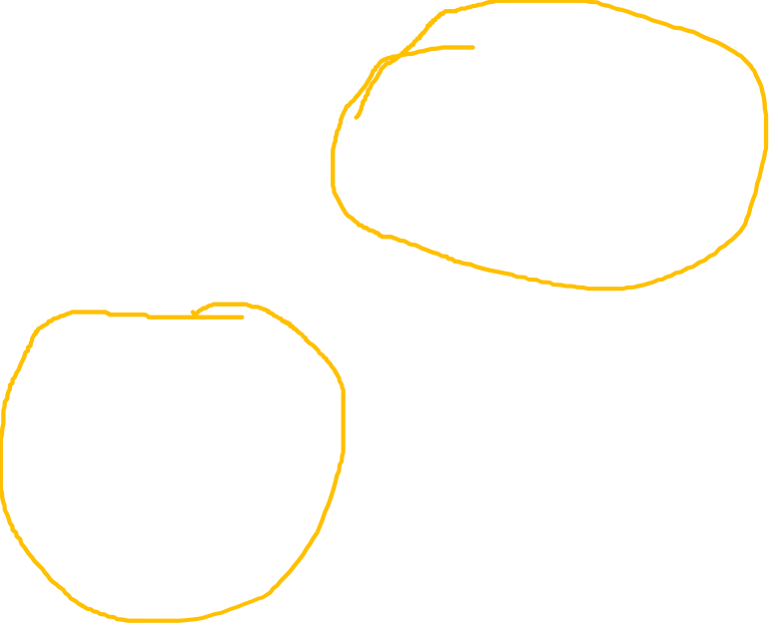

Slide 16
References
“284-288-IETEP1001 Ijetsr PDF.” Scribd, Scribd, https://pt.scribd.com/document/410248962/1510557148-284-288-ietep1001-ijetsr-pdf.
Application of Matrices to Real Life Problems - Project Topics. https://www.projecttopics.org/application-of-matrices-to-real-life-problems.html.
Ltd, All Answers. “Application of Matrices in Real-Life.” UK Essays, UK Essays, 31 Dec. 2021, https://www.ukessays.com/essays/mathematics/application-of-matrices-in-real-life- problems.php.
Vedantu. “Application of Matrices in Science, Commerce and Social Science Fields.” VEDANTU, Vedantu, 24 Mar. 2022, https://www.vedantu.com/maths/application-of-matrices.

